Slide 1
STREAMS

Slide 2
TEAM
Jayakumar MHK
K Chandana
Karan

Slide 3
INTRODUCTION
01
Readable Streams
02
TABLE OF CONTENTS
03
Writable Streams
04
Duplex

Slide 4
01
Introduction

Slide 5
Streams
A stream is an abstract interface that lets you perform specific tasks continuously. A stream is an EventEmitter that implements different methods. A user can use streams to perform a variety of functions like read, write, read & write, and transform functions.
In a Node.js environment, streams are used to work with streaming data. It provides users with an API that helps them in creating the streaming interface. The data here is received in parts and is read in parts as well.

Slide 6
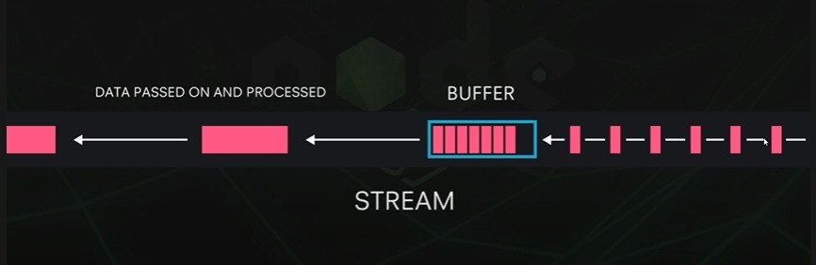
Architecture

Slide 7
Buffer
A buffer is an area of memory.
It represents a fixed-size chunk of memory (can't be resized) allocated outside of the V8 JavaScript engine.
You can think of a buffer like an array of integers, which each represent a byte of data
Buffers were introduced to help developers deal with binary data, in an ecosystem that traditionally only dealt with strings rather than binaries.

Slide 8
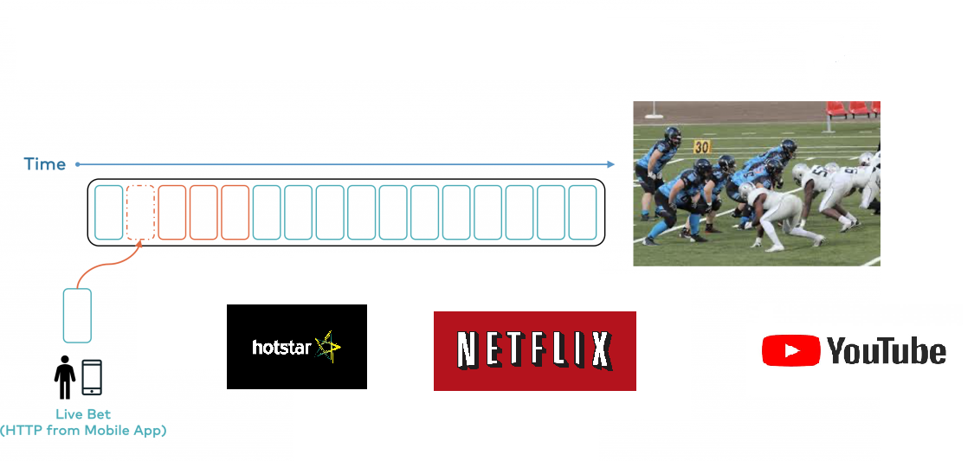
Real Time Example

Slide 9
02
Readable Streams

Slide 10
Readable Streams
A readable stream lets you read data from a source.
A readable stream is the one from which you can read data. They come in two variants or two different reading modes – Paused and Flowing. All the readable streams run in pause mode unless you mingle with them. It means users have to request to get an output from the stream. Flowing mode ensures that the data flows continuously. You can choose to either consume or ignore the output that you see on the screen.

Slide 11
fs.createReadStream() —- lets us read the contents of a file.
The fs.createReadStream function is used to create a readable stream or you can read() continuously until all of the data finishes reading. To make the stream flow, you will need an additional bit of code.

Slide 12
03
Writable Streams

Slide 13
Writable Streams
A writable stream lets you write data to a source.
fs.createWriteStream() —- lets us write data to a file using streams.
Writable streams allow users to write on the chosen destination. We use write() function to initiate a writable stream. The API here is simpler and prefers the use of methods instead of events. It is very easy for users to learn a writable stream.

Slide 14
04
Duplex Streams

Slide 15
Duplex Streams
Duplex streams, we can implement both readable and writable streams with the same object. It’s as if we inherit from both interfaces.
It’s important to understand that the readable and writable sides of a duplex stream operate completely independently from one another. This is merely a grouping of two features into an object.

Slide 16
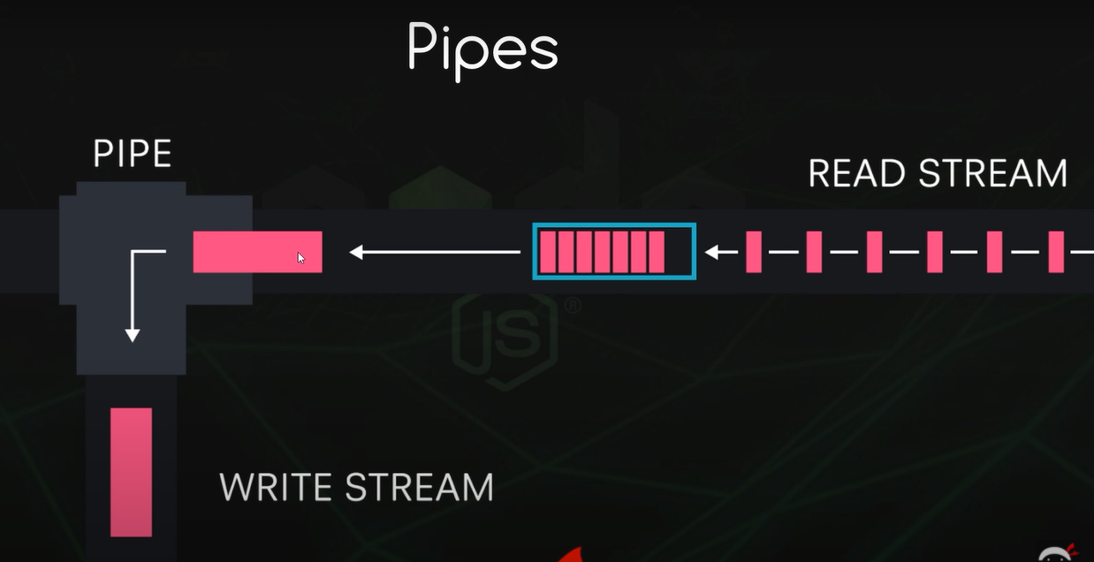

Slide 17
THANK YOU

